Slide 1


YOUTUBE SUMMARIZER:
SIMPLIFYING VIDEO CONTENT CONSUMPTION

Slide 2
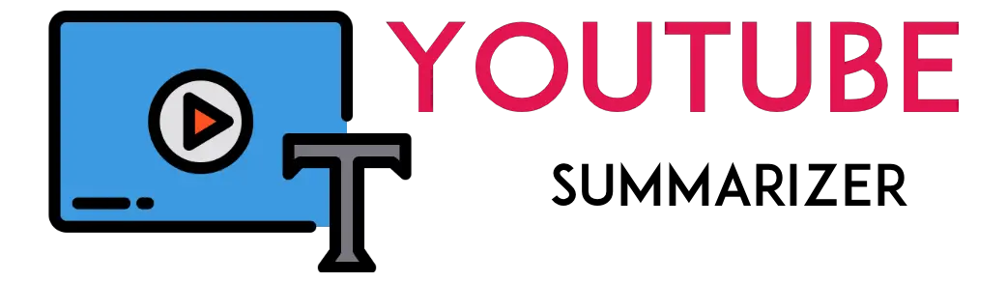
INTRODUCTION
SUMMARIZE YOUTUBE VIDEOS AND IDENTIFY THE IMPORTANT IDEAS AND FACTS OF VIDEOS.
EXTRACTING IMPORTANT FACTS FROM LENGTHY YOUTUBE VIDEOS

Slide 3
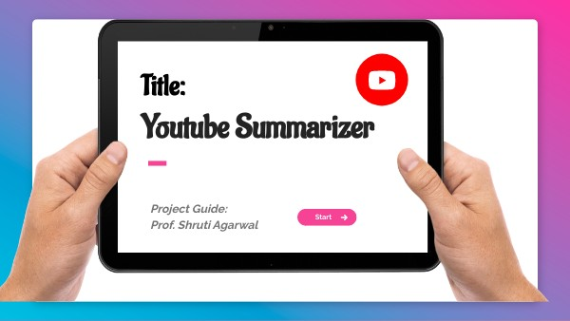
INDEX
PURPOSE
PROBLEM STATEMENT
SOLUTION
KEY FEATURES
USE CASES
LIBRARIES
SYSTEM DESIGN
FUTURE SCOPE
CONCLUSION
REFRENCES

Slide 4

PURPOSE
IF YOU DO NOT HAVE TIME TO WATCH LONG VIDEOS, YOU CAN SUMMARIZE THEM WITH ONE CLICK. COPY THE LINK OF THE VIDEO FROM YOUTUBE THEN PASTE THE LINK IN THE AREA FOR THE LINK THEN MAGIC WILL HAPPEN. YOU CAN READ BRIEF SUMMARY OF VIDEOS AND TAKE NOTES FOR YOURSELF.

Slide 5

PROBLEM
TIME CONSUMING
THE ISSUE WITH THE CONTENT ON YOUTUBE IS THAT THERE’S A LOT OF IT. THE DOWNSIDE OF THIS IS THAT IT GIVES RISE TO INCESSANT CLICKBAIT VIDEOS, WHICH END UP WASTING THE TIME OF THE USER.

Slide 6
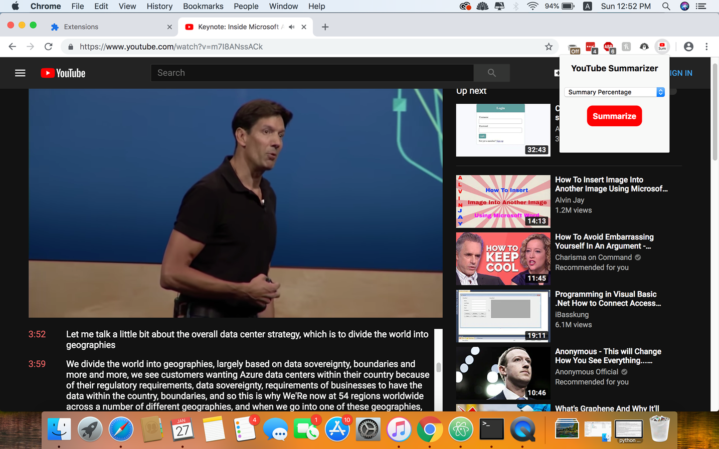
SOLUTION
HAVE YOU EVER IMAGINED HAVING A SHORT SUMMARY OF A LARGE YOUTUBE TUTORIAL OR VIDEO FOR RAPID READING BEFORE WATCHING THE VIDEO? THIS WILL UNDOUBTEDLY SAVE YOU A LOT OF TIME BY PROVIDING YOU WITH A QUICK UNDERSTANDING OR SUMMARIZATION OF THE VIDEO IN A SHORT PERIOD OF TIME

Slide 7



FEATURES
SAVES
TIME
FAST
SPEED
EASY
TO USE

Slide 8

USE CASES
EDUCATIONAL PURPOSES
RESEARCH AND ANALYSIS
CONTENT CURATION
PERSONAL USE
PROFESSIONAL USE

Slide 9
Libraries
1
STREAMLIT
2
SUMY
3
YOUTUBE_TRANSCRIPT_API
4
TRANSFORMERS

Slide 10
System design
1
BACK END
We have created a back-end application directory containing files written in Python.
2
PERFORM TEXT SUMMARIZATION
Text summarization is the task of shortening longer text into a precise summary that preserves key information content and overall meaning. The transformers library is used for text summarization.

Slide 11
System design
3
GET TRANSCRIPTS
In this module, we are going to utilize a python API(youtube-transcript-api) which allows you to get the transcripts/subtitles for a given YouTube video
4
REST API ENDPOINT
The following step is to define the resources that will be used in implementation by this backend service.

Slide 12
System design
5
USER INTERFACE
User interface is needed to ensure that the user can interact with the system at ease.
The Streamlit library is used to create the web application and user interface.
6
NLTK (NATURAL LANGUAGE TOOLKIT)
The NLTK library is used for natural language processing tasks, such as tokenization and stemming, to preprocess the text data.

Slide 13
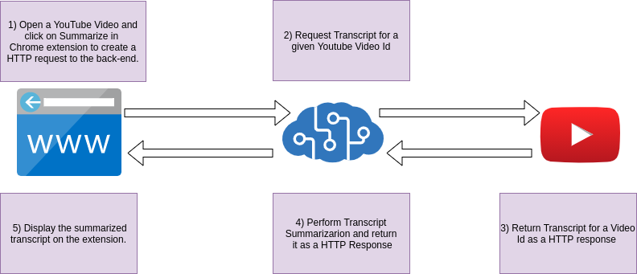
1)Open YouTube video of your choice, copy its link, paste its link on out website and click Summarise.
2)Request transcript for a given video
5)Display summarised text on your screen
4)Perform Transcript summarisation and return it as http response
3)Return transcript for a videoID as http response.
System design

Slide 14
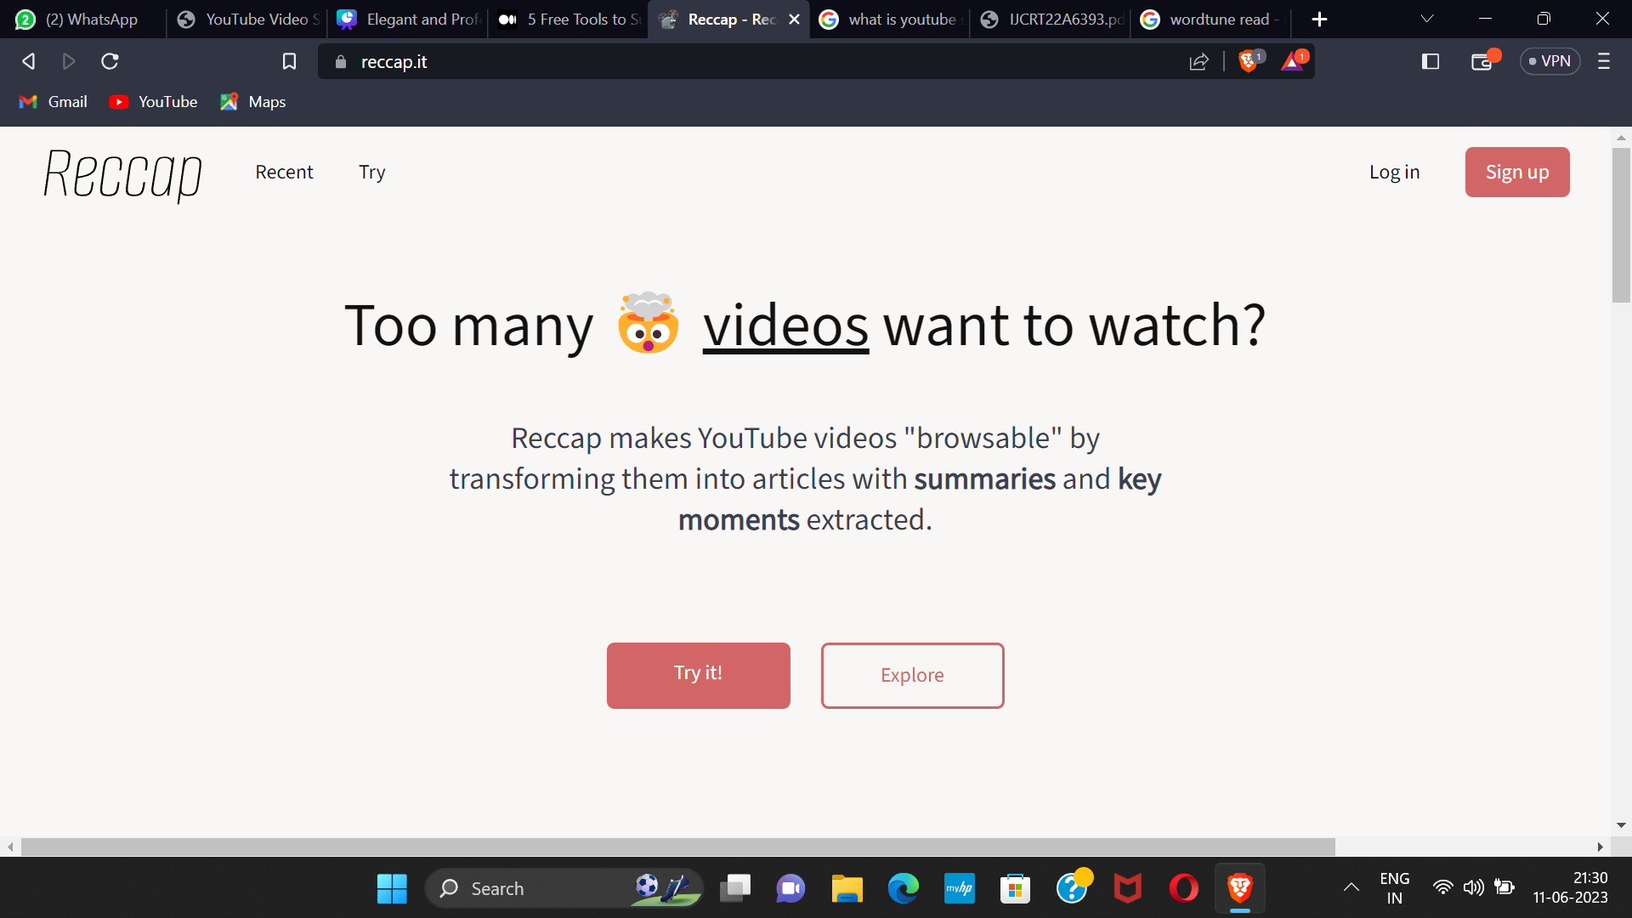

USE CASES
WORD TUNE and RECCAP are tools used for summarizing youtube videos

Slide 15

FUTURE SCOPE
ADVANCED SUMMARIZATION TECHNIQUES
INTEGRATION WITH OTHER PLATFORMS
MULTILINGUAL SUPPORT
USER FEEDBACK AND UPDATES
EXPANSION TO OTHER MEDIA TYPES

Slide 16
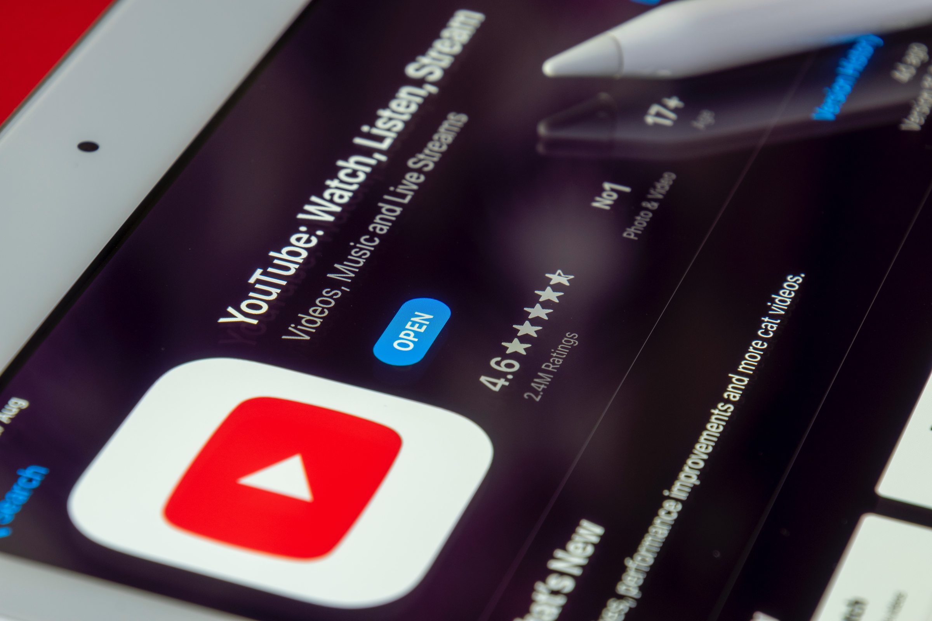
CONCLUSION
THIS PROJECT HAS PROPOSED A YOUTUBE TRANSCRIPT SUMMARIZER. THE SYSTEM HAS A BLACK BOX TO BE FILLED BY THE DESIRED YOUTUBE LINK WHICH IS TAKEN AS INPUT, WHEN THE USER CLICKS ON THE SUMMARIZE BUTTON ON THE WEB PAGE, OUR SYSTEM WILL FETCH THE THE TRANSCRIPTS OF THAT VIDEO WITH THE HELP OF PYTHON API. THE ACCESSED TRANSCRIPTS ARE THEN SUMMARIZED WITH THE TRANSFORMERS PACKAGE. THEN THE SUMMARIZED TEXT IS SHOWN TO THE USER ON OUR WEB PAGE.

Slide 17
REFERENCES
[1] I. Awasthi, K. Gupta, P. S. Bhogal, S. S. Anand and P. K. Soni, "Natural Language Processing (NLP) based Text Summarization - A Survey," 2021 6th International Conference on Inventive Computation Technologies (ICICT), 2021, pp. 13
[2] AdhikaPramitaWidyassari, SupriadiRustad, GuruhFajarShidik, Edi Noersasongko, Abdul Syukur, Affandy Affandy, De Rosal Ignatius Moses Setiadi,Review of automatic text summarization techniques &methods,Journal of King Saud University
[3] P. R. Dedhia, H. P. Pachgade, A. P. Malani, N. Raul and M. Naik, "Study on Abstractive Text Summarization Techniques," 2020 International Conference on Emerging Trends in Information
[4] A. Dilawari and M. U. G. Khan, "ASoVS: Abstractive Summarization of Video Sequences," in IEEE Access, vol. 7, pp. 29253-29263, 2019, doi: 10.1109/ACCESS.2019.2902507.
[5] https://huggingface.co/transformers/installation.html

Slide 18

THANK YOU

